Slide 1

Car Rider Pickup System for Schools
Haya Abusada, Jake Hewett, Jayden Pearson, Jack Uehlinger, Sara Vorhaben

Slide 2
Problem Background
Over 70% of students are now picked up via car, creating massive congestion.
Parents wait up to 1 hour, with lines often forming 1-2 hours before dismissal.
Queues spill onto local highways, causing traffic backups and increasing accident risks.
Inclement weather increases delays as bus and bike riders often switch to the car line.
The manual process requires 5-10 staff members daily, diverting them from educational duties.

Slide 3
Problem - Needs Statement
School pickup via the car rider line has been increasing in the US over the years leading to an increase in line length and pickup time. Now, over 70% of students are picked up from school via the car rider line. Car rider lines have become congested, posing a safety issue for both the students and other drivers. With more students attending school, car rider lines have become too slow and cause parents to wait up to over an hour in line leading to frustration. Some studies show that the car rider pick-up line starts to form 1-2 hours before school actually gets out, which leads to traffic backing up local highways and streets, and even frequent accidents. Inclement weather further slows the line, as students who ride the bus or bike to school will often be picked up by their parents in the car rider line to avoid the weather. Additionally, 5-10 staff members are required to set up and run the pickup process, diverting their time away from the education of students. An automated system is needed to streamline the pick-up process to decrease delays and safety issues.

Slide 4
Goal and Objectives
Goal
The goal of this project is to design and prototype a system that will help automate the car rider pick up process at schools. The system is built to reduce the amount of time necessary to pick up students from school.
Objectives
The system will allow parents to update their information (license plate numbers, approved adults for pickup, car rider schedules) via a website with approval from a staff member of the school.
The system will read the marker on the car (license plate, QR code, nametag) as it enters the pickup line and send the information to a server.
The server will identify the parent and child associated with the car marker, and update a display at the entrance of the pickup line to direct the car to the proper station.
The laptop at the front of the school is updated to inform the students and staff which child is being picked up, and which zone to go to.

Slide 5
Goal and Objectives - Requirements
Marketing Requirements
Make the pickup process faster for parents
The system should be easily updated
The system should be low cost
The system should be easy to use/install
Information must be validated if updated or inserted
Student safety should be ensured (information, physical, etc.)
The system should be reliable

Slide 6
Goal and Objectives - Requirements
Marketing Requirements | Engineering Requirements | How Requirement was met
1 | Pickup time should be reduced by 30% per 100 kids. The time from the car entering the view of the camera to information being displayed should be no more than 5 seconds. | display updates <1 second
4 | 7 inch (diagonal) display screen to give station and process instructions clearly. | See Setup
1, 6 | Per Texas Family Code, ensure that students are referred to authorized parents 100% of the time. | Scanned QR code only works for approved users
6 | Private Information stored in the database should be encrypted using 128 bit encryption. | Database automatically encrypts
1,6,7 | Should correctly identify/assign parents to kids 100% of the time. | See Full System Test
3 | The costs for developing the system should not exceed $300. | See Budget
2,4,5 | The system should allow parents to submit a request to the school to update information and the school should receive the request all within 1 minute. | Aproval requests can be seen in system in <1 second

Slide 7
Goal and Objectives - Requirements
Marketing Requirements | Engineering Requirements | How Requirement was met
4 | The system should have a modular design such that failed components can be replaced by a technician in under 15 minutes. | System designed so each system component could easily be replaced if broken
7 | The software will comply with the Digital Millennium Copyright Act. | No code was copied from existing sites
2,4,5,6 | Staff should be able to access databases with provided credentials and view all parent to children links. | See staff portal
1 | Minimum 40inch (diagonal) display screen to give station and process instructions clearly inside in the pickup . | See System Setup: display Student Pickup screen inside on TV/Smartboard in classroom
4,7 | The system should be mounted correctly on a tripod to ensure stability and prevent hazards. | See Car Entrance Model Setup.

Slide 8
Design Constraints and Feasibility
Technical and Temporal Constraints
Maximum of 5 seconds from image capture to display update
Identification accuracy must be 100% to ensure safety and efficiency
Connection between the system parts must be reliable
Physical and Environmental
Needs to withstand outdoor elements (wind and rain)
Needs to be portable and stable with modular parts, mounting, and power supply to reduce system downtime and speed up repair and maintenance
Economic
Must cost $250 or less, necessitating cost-effective components
Feasibility
Core technology, such as Python image processing and Wi-Fi, is well documented and achievable
Main challenge will be creating a fast and efficient system within our budget

Slide 9
Design Alternatives and Rationale
Solution | Pros | Cons
Manual Pickup App (PikMyKid) | Easy to implement; low cost; reduces paperwork | Requires staff queue management; no automated vehicle identification
Integrated Dismissal System (Beeline) | Improves communication; integrates with school systems | Requires training and infrastructure; still staff-monitored
Geofencing (Car-Pool App) | Real-time arrival alerts; reduced manual check-ins | Dependent on GPS accuracy, mobile devices, and connectivity
GPS Check-In (IschoolRide) | Keeps students inside until arrival; reduces idle staging | Relies on parent app usage and accurate GPS; staff verification will still be needed
All alternatives improve organization but still rely on staff actions, limiting full automation.

Slide 10



System Level Functional Description - High-Level Block Diagram
Car line entrance
Scan QR code from parents
Send QR code data to server, receive zone color
Instruct parents what color zone to go to
Allow volunteers/adults to see kids in each zone from update zones when a kid has been picked up
Accessible through mobile device (volunteer’s phone)
Car Entrance Module
Zone Pickup Module
Car Stations
--------------------------------
Display website which contains instructions to send kid to car stations
Kids Waiting Module
Host a website that can be updated in real time
Connect to a database that contains parent/kid info
Handle information update requests from parents
Send updates to car entrance module
Main Server Module
Notes:
range

Slide 11
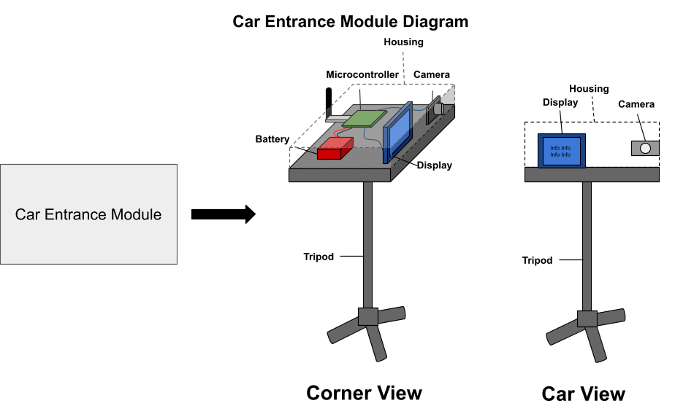
System Component - Car Entrance Module
Hardware:
Microcontroller for processing and controlling devices
Camera for images
Display for instructing parents
Rechargeable battery for power
Software:
Image processing software
Display instructions on screen
Server communication software
Interfaces:
Inputs:
Images
Zone color from server
Outputs:
Display information to instruct parents
QR code data to server

Slide 12
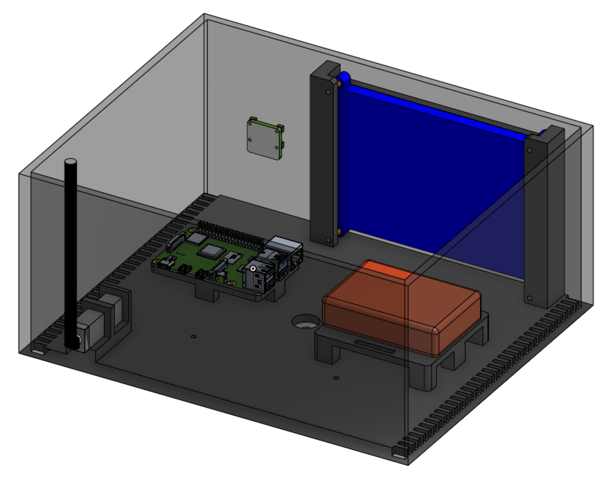
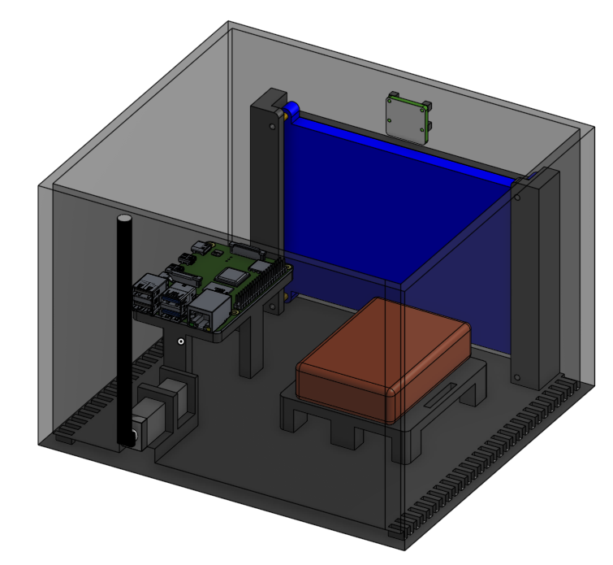
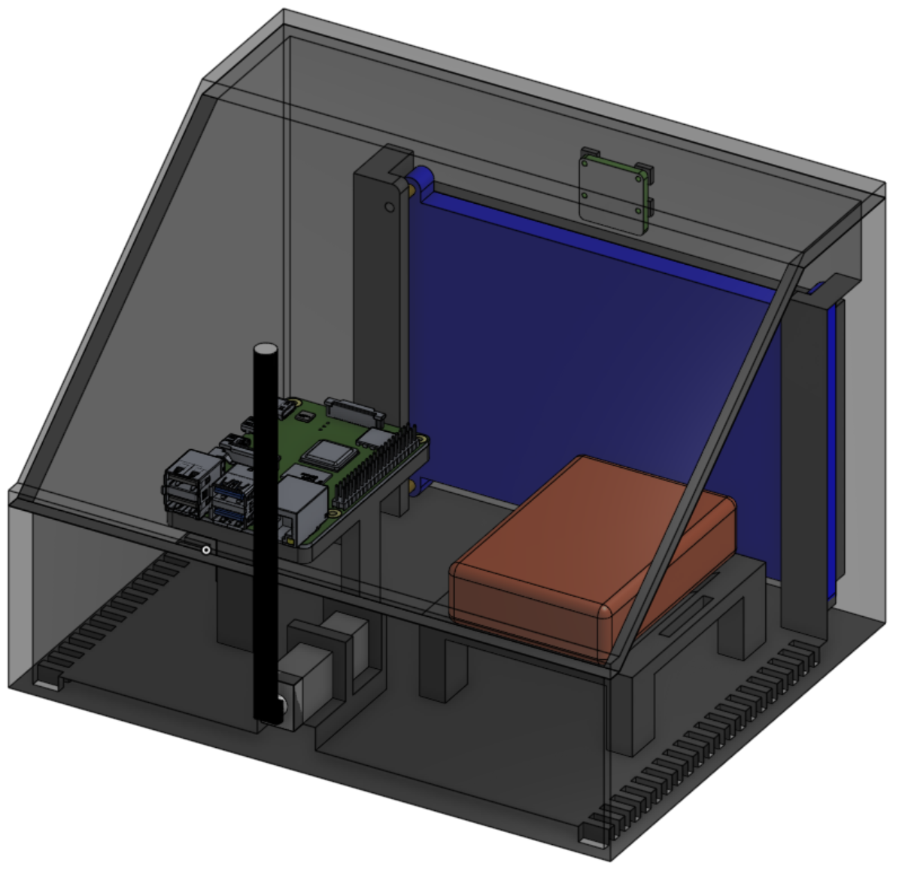
System Component - Car Entrance Module cont.
Car Entrance Module Design Progression:
Initial Design
First Re-design
Final Design

Slide 13
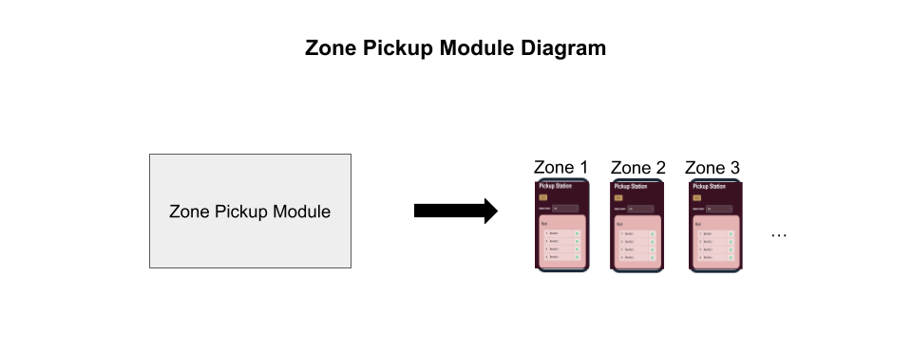
System Component - Zone Pickup Module
Hardware:
Mobile devices to display zone information
Software:
Website access on devices
Interfaces:
Inputs:
Button input on phones once a kid has been picked up
Outputs:
Website for volunteers to see

Slide 14
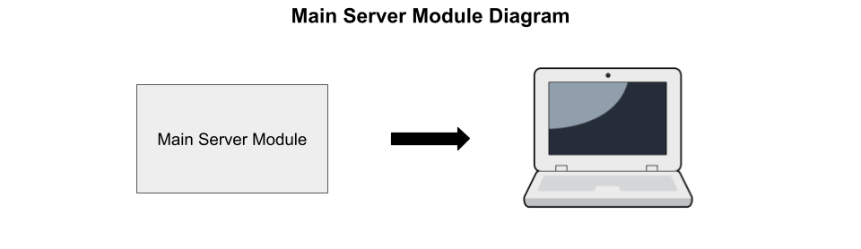
System Component - Main Server Module
Hardware:
Computer to run software
Software:
Website hosting - needs real time updating
Database connection to access and update parents/kids info
Server - allow the website and microcontroller to communicate
Interfaces:
Inputs:
QR code data
Parent requests (to update information)
Outputs:
Information to update car entrance module display
Website

Slide 15
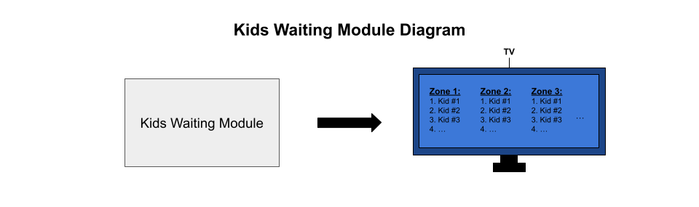
System Component - Kids Waiting Module
Hardware:
Large display (projector or large TV)
Software:
Website access on screen
Interfaces:
Inputs: None
Outputs:
Website to instruct kids and staff when to
send kid to zones to be picked up (also which
zone to go to)

Slide 16
Budget Breakdown
Module | Component | Description | Qty | Unit Cost ($) | Total Cost ($)
Car Entrance | Tripod | Tripod to support car entrance module housing. | 1 | $22 | $22
Car Entrance | Raspberry Pi | Microcontrollers to control car entrance and zone pickup modules. | 1 | $75 | $75*
Car Entrance | Raspberry Pi Camera | Camera to use license plate recognition of cars. | 1 | $55 | $55*
Car Entrance | 10000mAh Rechargeable Battery | Batteries to give sufficient power to the car entrance and zone pickup module. | 1 | $40 | $40
Car Entrance | 7-inch display | Display to inform the parent of the car what zone to go to, and verify we have matched their car with their kid. | 1 | $38 | $38*
Car Entrance | HDMI Cord | HDMI cord to connect the microcontroller to the display. | 1 | $4 | $4
Car Entrance | 3D printing | 3D printed housings for car entrance and zone pickup modules. |  |  | $36.55**
Car Entrance | Mounting Screws | Screws to securely mount components to housings. | ~40 | $8 (600pcs) | $8
Total* (not including components provided) |  |  |  |  | $74
Total |  |  |  |  | $278.55

Slide 17
Budget Breakdown - cont.
Parts Purchased but Not Used:
Total Spent by us: $74 + $64 = $138
Module | Component | Description | Qty | Unit Cost ($) | Total Cost ($)
Car Entrance | Zigbee Antenna | Antennas for wireless communication between car entrance and zone pickup module. | 2 | $27 | $54***
Car Entrance | Wires | Wires to connect components. | ~20 | $10 (240pcs) | $10***
Total |  |  |  |  | $64

Slide 18
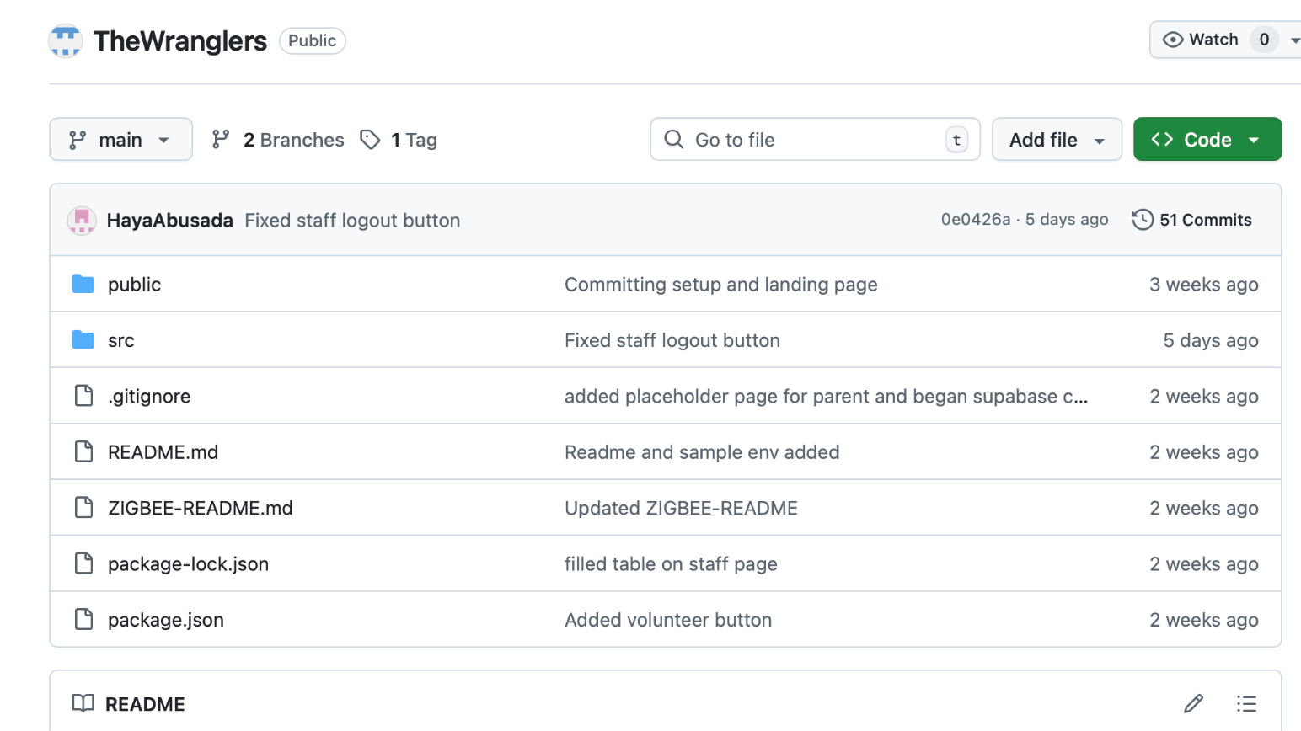
Evidence of Effective Teaming
Defined Roles and Responsibilities
Each team member is responsible for a specific subsystem:
Haya Abusada – Frontend development and system integration
Sara Vorhaben – Backend development and authentication
Jake Hewett – Database architecture and administrative interface
Jack Uehlinger – Hardware and camera integration
Jayden Pearson – Mechanical design and enclosure development
This ensures clear ownership of tasks and efficient development.
Collaboration and Communication
The team maintains strong coordination through:
Weekly team meetings to review progress and address issues
GitHub for version control and collaborative development
Discord and Text for daily communication and troubleshooting
Google Drive for shared documentation and reports
Screenshot of Github Repo

Slide 19
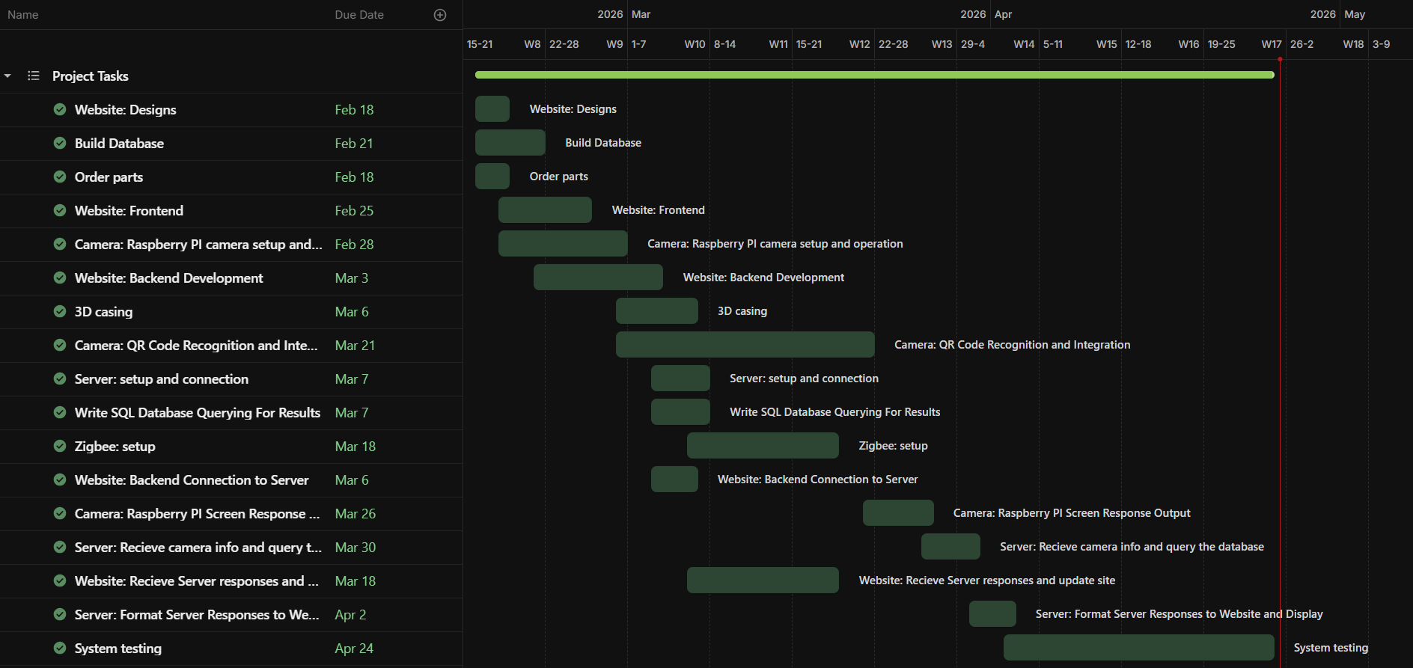
Evidence of Effective Teaming - Gantt Chart
Gantt Chart Shows all tasks completed
Red line is today

Slide 20
Environmental, Health, and Safety Concerns
Environmental Impact
Minimal hardware footprint (primarily existing devices like monitors and Raspberry Pi)
Reduced vehicle idling time → lowers emissions during pickup
Digital system reduces paper usage (no printed pickup lists)
Health Considerations
Contactless QR code system reduces physical interaction
Minimizes crowding and improves traffic flow for safer pickup conditions
Safety Considerations
Clear, color-coded display reduces confusion for drivers
Organized station system prevents congestion and accidents

Slide 21
Social, Political, and Ethical Concerns
Social Impact
Improves efficiency and reduces wait times for families
Enhances safety for students during pickup
Accessible interface designed for non-technical users
Ethical Considerations
Protection of personal data (student and parent information)
Use of secure authentication (Google OAuth)
Controlled access to staff-only features
Political / Regulatory Considerations
Must comply with school policies and student privacy regulations (e.g., FERPA)
Requires proper authorization for data collection and usage
Deployment depends on school/district approval and infrastructure

Slide 22
Manufacturability, sustainability, and economics
Manufacturability
Software-based system → easily deployable and scalable
Uses widely available hardware (monitors, laptops, Raspberry Pi)
No specialized manufacturing required
Sustainability
Reduces fuel consumption through optimized pickup flow
Digital-first approach minimizes material waste
Scalable system reduces need for additional infrastructure
Economic Considerations
Low implementation cost (open-source tools, cloud services)
Minimal hardware investment
Reduces labor inefficiencies and operational costs for schools

Slide 23
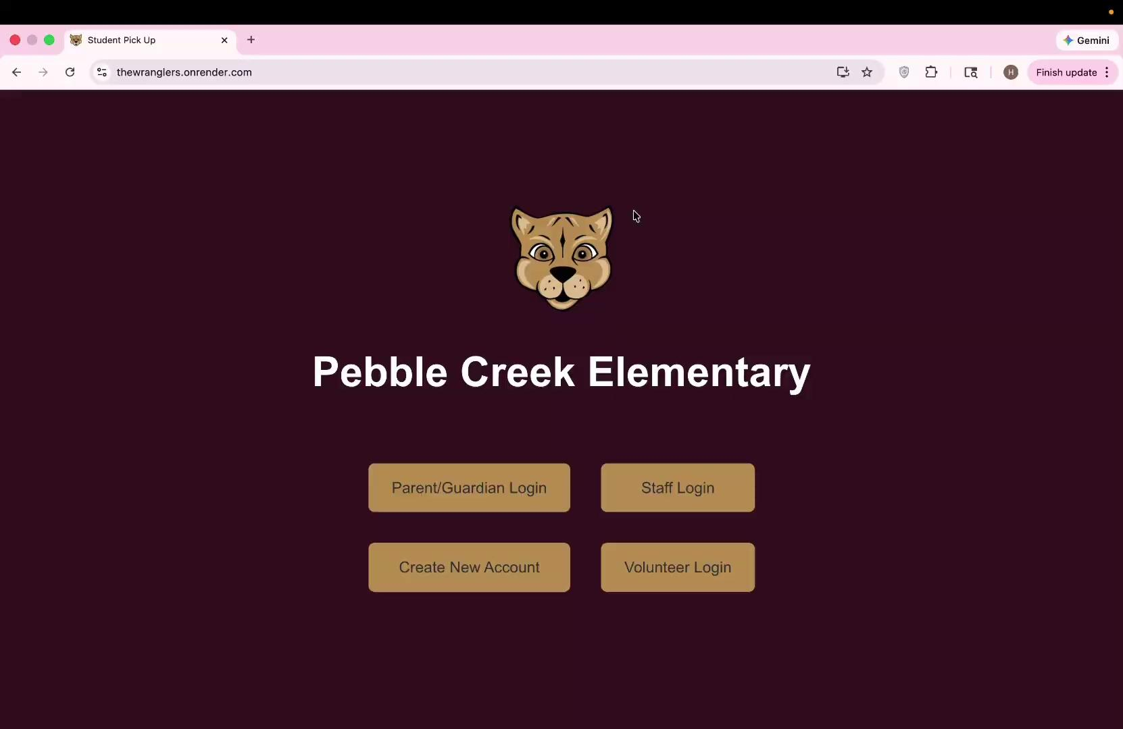
Our Final Product Video
video
Full System Test
Parent Creates an account
School Approves the account
Parent pulls up to the camera and scans QR code
At same time, inside school announces the pickup of students
Student then goes to the correct station, volunteer can check them off and they get to go home

Slide 24
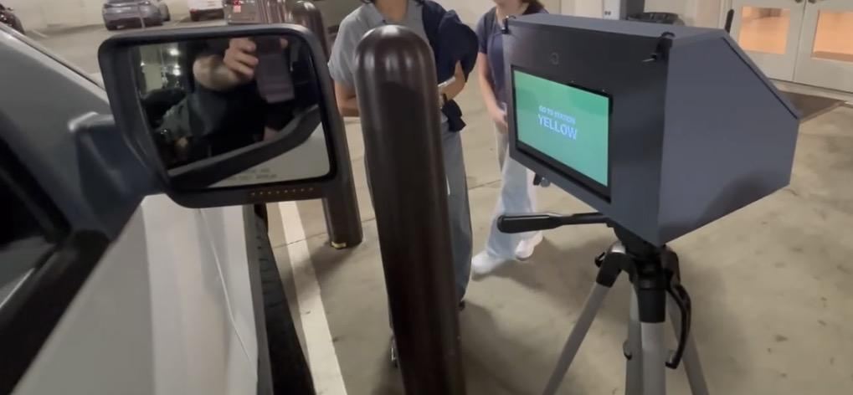
Testing and Results
Small, foundational testing first
Display text found by the camera directly to the screen it is connected to
Ping router from the car entrance module to verify connectivity
QUERY database to ensure proper initialization
System testing comes next
Packets should be sent to the database, should return student names
Screens directing drivers and students should update in no more than 5 seconds
Web server flags incoming requests to alter database to admin page
Notes:
Improve specs with respect to requirements

Slide 25
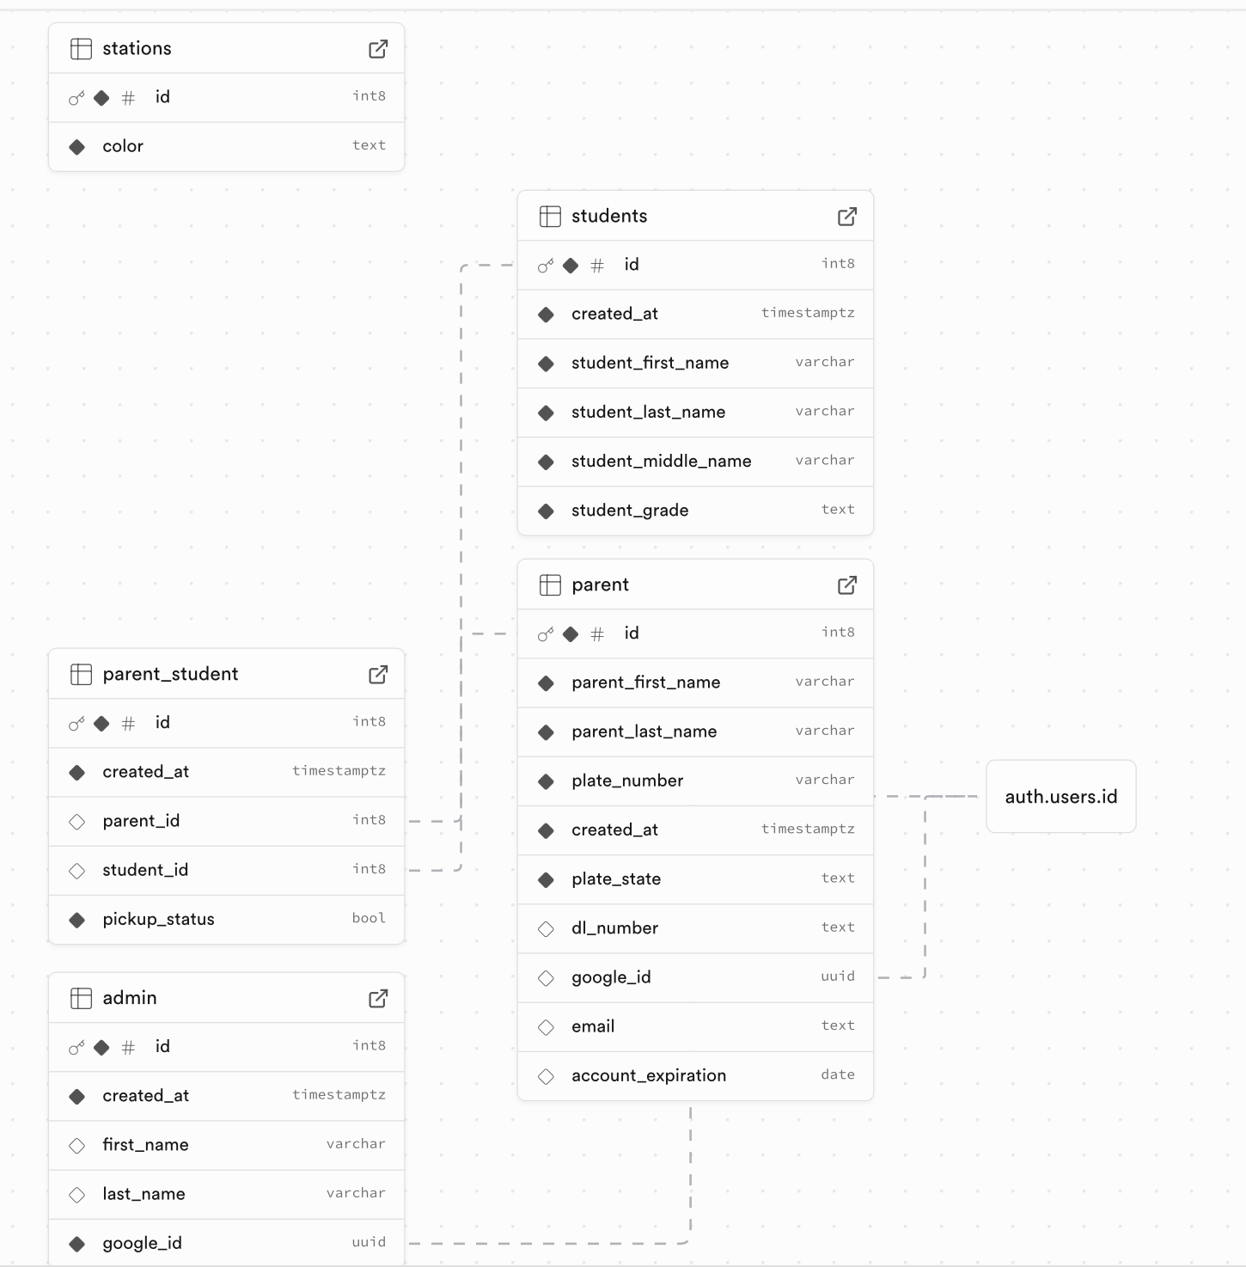
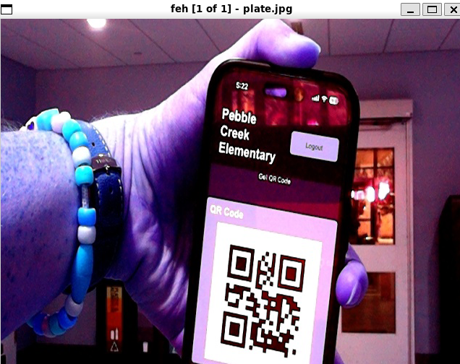
Results
Database Implementation
PostgreSQL database created using Supabase
Tables implemented for:
Parent accounts
Student records
Parent–student relationships
Pickup status tracking
System successfully inserts, retrieves, and updates records
Hardware
Raspberry Pi uses services to run program on startup
Display is connected to web server output
System can process images and detect QR codes
Mechanical Development
3D printed housing encloses all hardware components
Housing also mounts directly to tripod

Slide 26
Results
Some of the Results for Testing Can be seen below:
Test | Time To complete
Time for Someone with no experience to create and account and add a child | 44 Seconds
Time for Full system pickup (drive up, scan QR Code, Pull Forward) | 1 minute and 3 seconds for 2 cars
Time to approve student | ~2 seconds
Time to Generate Approved QR Code | Less than 1 second
Battery life of the Car Entrance Module | Greater than 2.5 hours
Time To Display Successful Result after QR Scan | ~1 second

Slide 27
Limitations
Zigbee Antenna Integration Removed
Initial plan included Zigbee communication between modules
Incorrect hardware was ordered and could not be programmed in time
System was redesigned to operate without Zigbee
License Plate Recognition Not Implemented
Tested but found to be unreliable
Performance varied significantly with lighting conditions, camera angle, and distance
Risk of incorrect identification was too high for real-world use
Dependence on Network Connectivity
System requires stable internet connection for real-time updates
Performance may degrade with poor connectivity

Slide 28
Future Improvements
Improved Identification Methods
Integrate more reliable computer vision models for license plate recognition
Combine QR codes with automated recognition for redundancy
Real-Time Communication
Replace polling with WebSockets or MQTT for instant updates
Improve system responsiveness and scalability
Scalability and Deployment
Support multiple schools or larger campuses
Add admin tools for managing stations and users dynamically
External Power Button
Current setup requires staff to lift lid and plug in battery
An external power switch would improve usability

Slide 29
Questions?
Thanks for listening!

